Slide 1
A Very Brief Overview
of
Maharishi AyurVeda

Slide 2
Maharishi AyurVeda
Positive behaviors that enhance health,
happiness and longevity
Behavioral Rasanyanas
Notes:
Behavioral Rasāyanas are positive behaviors that enhance health, happiness and longevity. They help us to grow in inner strength, clarity, and everything needed to move closer to our goals in life.

Slide 3
Maharishi AyurVeda
Behavioral Rasanyanas
1. Maintain a positive, calm outlook.
2. Practice cleanliness of all kinds.
3. Be charitable with your time, your attention, your actions, and your finances.
4. Follow the precepts of your religious or spiritual beliefs. Meditate regularly. Be devoted to knowledge and developing higher states of consciousness.

Slide 4
Maharishi AyurVeda
Behavioral Rasanyanas
5. Be loving and compassionate.
6. Always speak the truth, but speak sweetly. Speak well of others. Speak in a way that uplifts people. Avoid harsh or hurtful speech and speaking ill of others behind their backs
7. Perseverance
8. Avoid conceit, pride, arrogance, egotism, or selfishness

Slide 5
Maharishi AyurVeda
Behavioral Rasanyanas
9. Be free of anger, violence, and hostility
10. Moderation and self-control in any activity that can lead to imbalances
11. Avoid coveting another's possessions

Slide 6
Maharishi AyurVeda
Behavioral Rasanyanas
12. Culture humility, innocence and simple, guileless behavior. Avoid dishonesty or duplicity
13. Have respect toward teachers, parents and elders
14. Keep the company of the wise, of people who uplift and bring out your best.

Slide 7
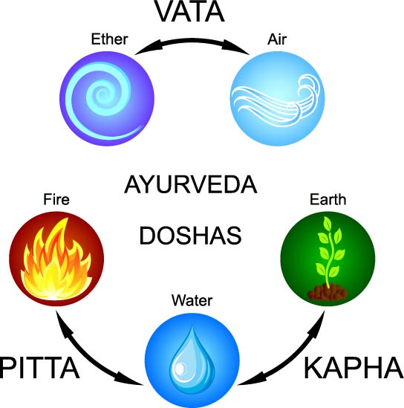
Maharishi AyurVeda
The 3 Doshas
Notes:
From the perspective of Ayurveda, the human body and all of its functions are governed by these subtle types of energy or functioning principles. They create our mind-body type.
Vāta (air, space, motion),
Pitta (fire, water, metabolism),
Kapha (earth, water, structure).

Slide 8
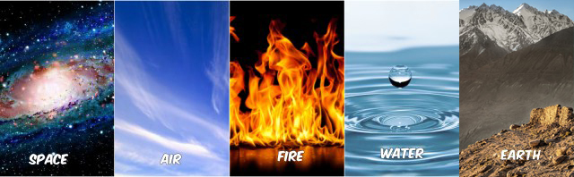

Earth
Everything in creation is made up of 5 elements,
including us. Each one of us is a unique combination
of these elements – and the basic types of energy
or functioning principles that are present in them.
Notes:
This is another way we find ourselves as a part of Nature.

Slide 9



The Doshas—Vata, Pitta, and Kapha
Vata has the characteristics of air and space,
is light, and is responsible for movement.
Pitta has the characteristics of water and fire, is hot, and is responsible for digestion and metabolism.
Kapha has the characteristics of earth and
Water, is heavy, and is responsible for structure
and lubrication.
Notes:
Vata is characterized by the mobile nature of Wind (Air) energy.
Pitta embodies the transformative nature of Fire energy.
And Kapha reflects the binding nature of Earth and Water energy.

Slide 10
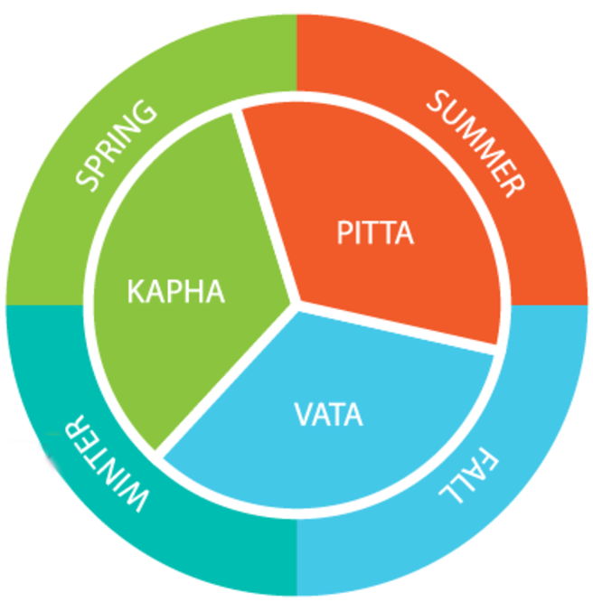
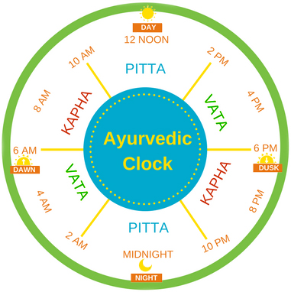
The Times of Day
The Seasons
Notes:
The three Doshas govern and are seen in the different times of day, in the seasons of the year: as well as in our individual physiologies.
Aligning the rhythms of individual life to the rhythms of nature is beneficial for all aspects of mental and physical health.
For example, following the Ayurvedic daily routine of rising before 6:00 am, Vāta time, brings with it the qualities of Vāta—lightness, freshness, alertness, and quickness.
Sleep is aided by going to bed before 10:00 pm, Kapha time, taking advantage of the heavier, settling influence of Kapha

Slide 11
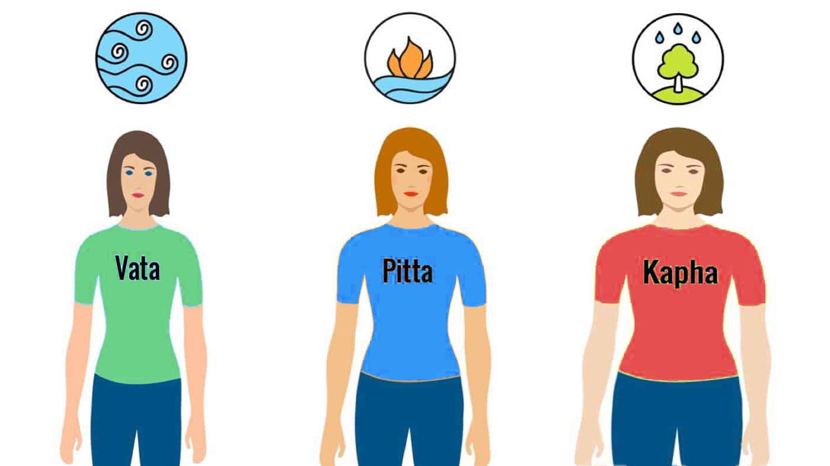
Your dosha makeup, or prakriti, determines everything from the shape of your body to the way your mind, emotions, and body work.
It is your underlying, unique nature.
Notes:
Slide…Understanding your prakriti is interesting and very useful, as it gives you insights into who you are, and why you respond individually to the world around you the way you do.
Each of us is a varying and unique combination of Vata, Pitta, and Kapha. No one is made up of just one dosha. All three of these principles are in everyone – but we will have one or even two that predominate, or in some people, all three in equal amounts.

Slide 12



Slide 13


Slide 14



Slide 15


Slide 16



Slide 17


Slide 18
Take the Dosha Quiz, twice!
Prakriti: Your basic, underlying nature, your lifelong characteristics.
Vikriti: is a snapshot of who you are at the time that you take the Dosha Quiz. It’s a temporary state of balance or imbalance. It will tell you where to put your attention, and then you can use diet, routine, and lifestyle changes to gently bring yourself back to balance.
Notes:
Take the quiz twice, in these 2 ways:
The first time, Answer the questions based on what seems true about you over the length of your life. This will help you understand your basic, underlying nature, your lifelong characteristics.
The second time, Answer the questions based on how you feel right now. This will help you understand your current state of balance or imbalance, and the reason behind any imbalances you may be experiencing presently.

